Slide 1
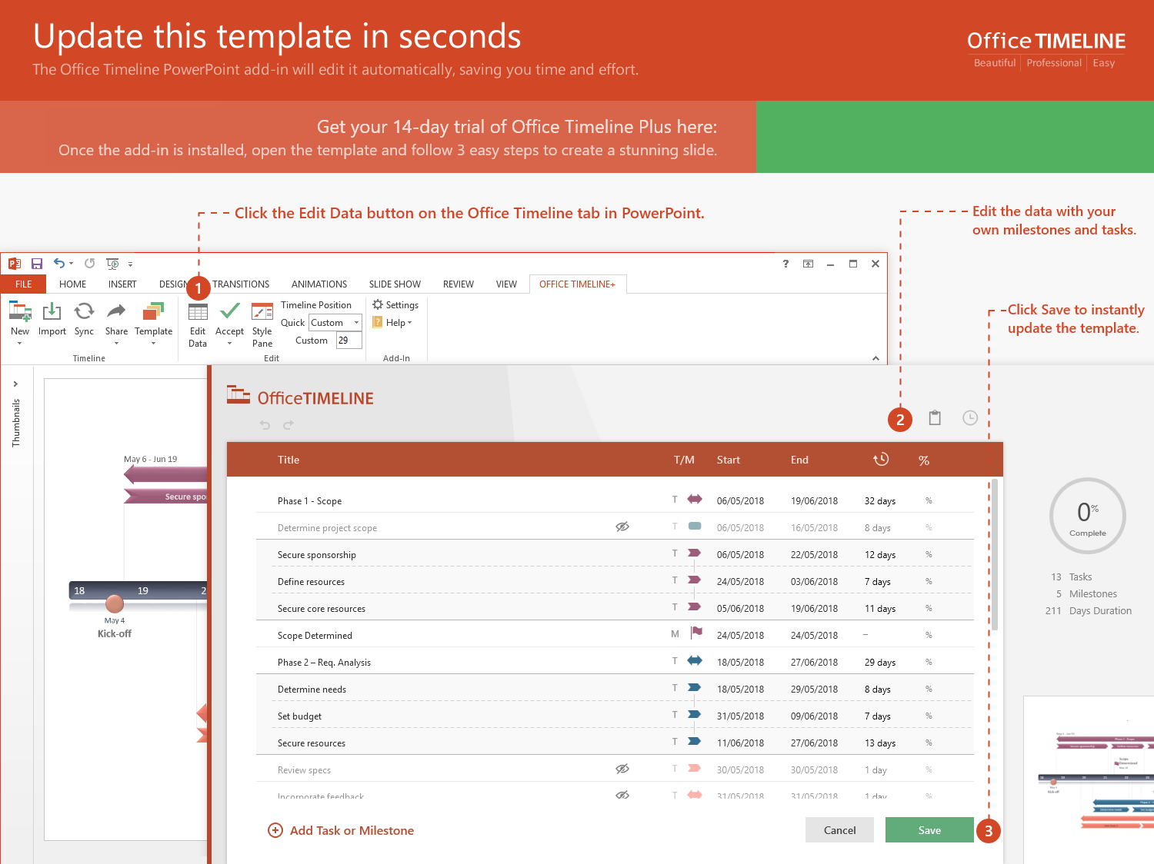
https://www.officetimeline.com/14-days-trial

Slide 2
5 Year Plan Timeline Template
100 days
Jan 15 - Jun 3
Description of features used/or planning to be used
0%
200 days
Jan 17 - Oct 23
Description of data collection process
0%
37 days
Apr 4 - May 26
Algorithm description
0%
60 days
Apr 4 - Jun 26
Complete Design
0%
100 days
Feb 4 - Jun 23
Complete Implementation
0%
145 days
Apr 7 - Oct 26
Indicate the parts of the project that have been completed
0%
149 days
Apr 7 - Oct 31
Indicate the parts which have not been completed and how do you plan to accomplish them for the final project report
0%
297 days
Nov 7 - Dec 27
Final report due
0%
2019
Q1
Q3
Q1
2020
Q3
Q1
2021
Q3
Q1
2022
Q3
Q1
2023
Q3
2023
Today
Oct 15
May 1
Jan 10
Dec 1
Beta. 1.34
Meeting
Version 2
Main Event
Nov 1
Testing 2.1
May 1
Jan 1
Presentation
Checkpoint
Jul 1
Marketing Process

