Slide 1
Event Planning Timeline
Milestone 3 Here
Milestone 1 Here
Milestone 2 Here
May 9
Milestone 4 Here
Kick-Off
Close
Feb 4
Mar 14
Apr 11
Jun 4
Jun 24
Day 1
13
25
37
49
61
73
85
97
109
121
133
Task 5 Here
38 days
Apr 17 - Jun 7
Task 4 Here
51 days
Mar 20 - May 29
Task 3 Here
46 days
Mar 8 - May 10
Task 2 Here
44 days
Feb 28 - Apr 30
Task 1 Here
51 days
Feb 1 - Apr 12

Slide 2
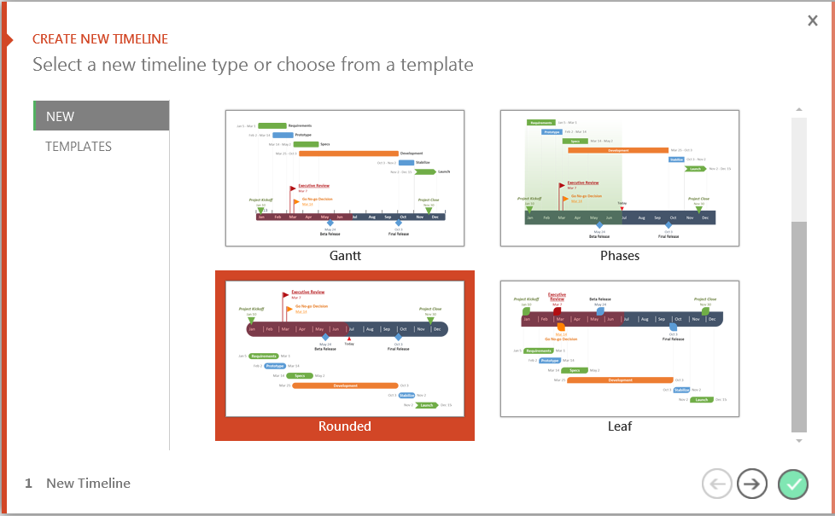
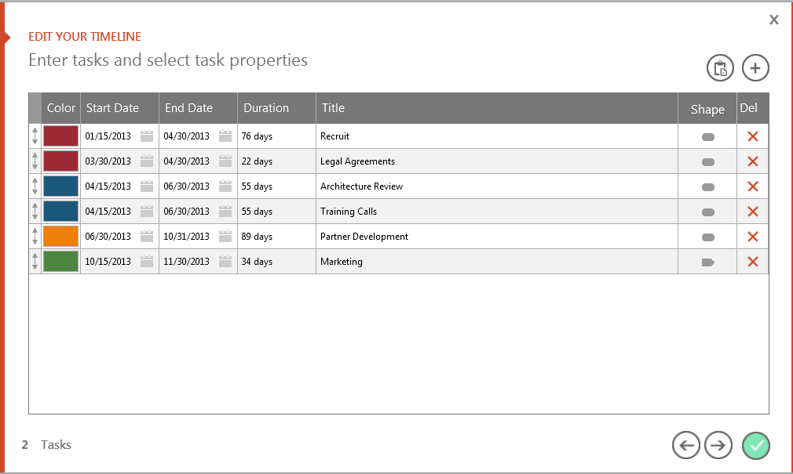
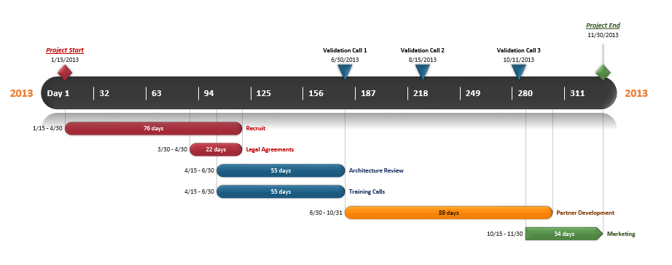
You can easily change this template or build new
timelines quickly, right inside PowerPoint!
Office Timeline is a FREE, award winning, timeline maker that's really easy to use.
Simple, easy-to-use wizards.
Professional, quick results.
Built directly into PowerPoint
1
Open your template or select a new one.
2
Choose dates, colors and shapes.
3
Click Finish to create your slide.

Slide 3

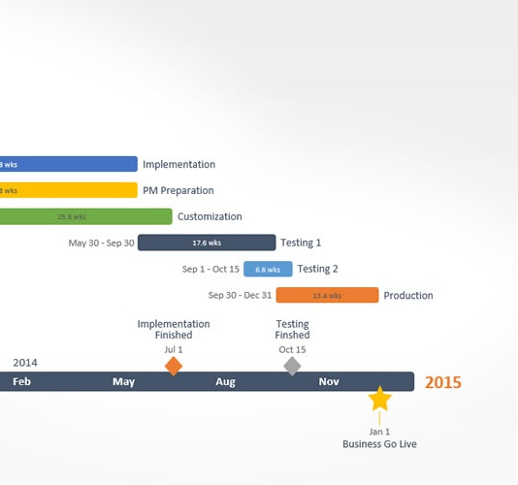
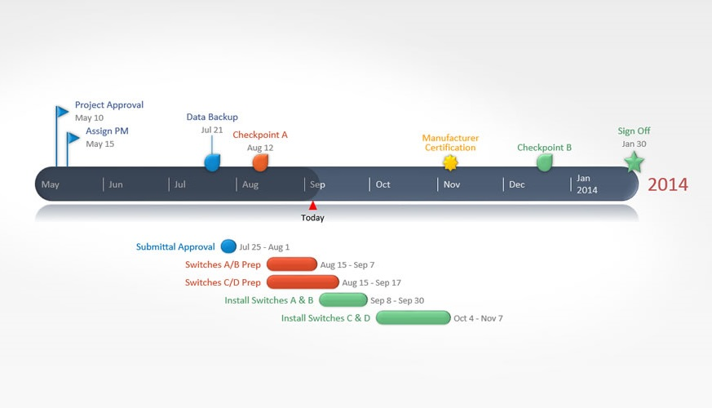
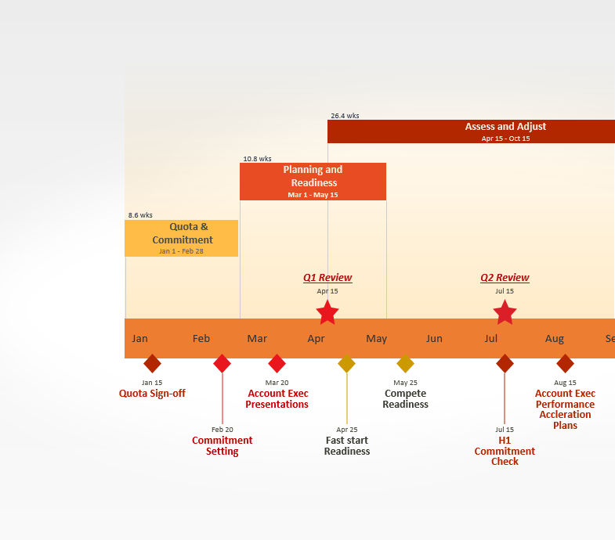

Get the Free Edition Now
FREE DOWNLOAD
Easily edit this template and create other
beautiful timelines quickly, right inside PowerPoint.
Copyright © 2012, Office Timeline, LLC. All rights reserved.
Download Now
www.FPPT.com/OfficeTimeline

Slide 4
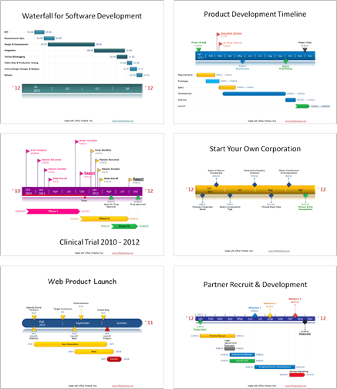
Stand out in a competitive market.
Impress customers, colleagues, and managers with professional timeline presentations built right from PowerPoint.
“
“I love this! I’ve been creating all these graphics manually for months and just wanted to smack myself upside the head when I saw this.”
“I can’t believe I’ve been using VISIO all these years! I've been missing out.”
“I've been building timelines for 22 years and this is the first tool I have found that quickly makes the kinds of slides my clients and management expect to see.
Copyright © 2012, Office Timeline, LLC. All rights reserved.

