Slide 1
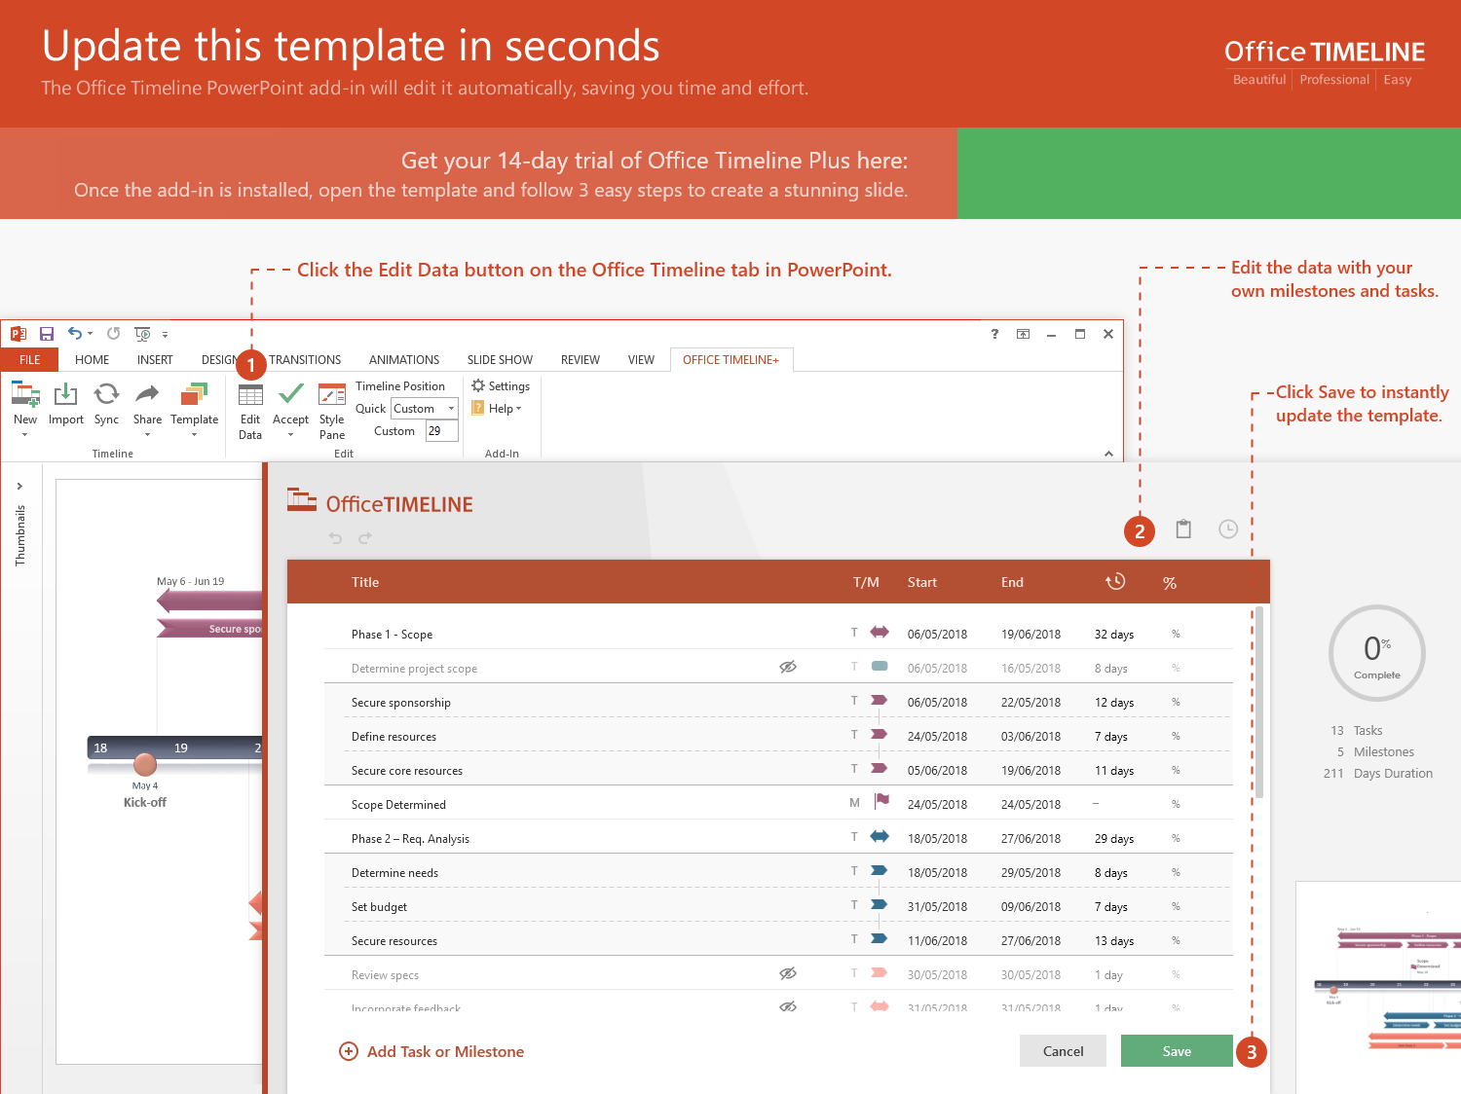
https://www.officetimeline.com/14-days-trial

Slide 2
Project Budget Timeline
2019
Day 1
58
115
172
229
286
343
2020
283 days
Today
Strategy Budget: $13,000
May 1 - May 31
53 days
128 days
102 days
90%
20%
73%
May 1 - Jul 12
Jul 13 - Jan 8
Jan 9 - May 31
Strategy: $4,500
Methodology: $2,500
Validation: $6,000
283 days
Execution Budget: $35,500
0%
May 1 - May 31
64 days
140 days
54 days
25 days
70%
50%
15%
80%
May 1 - Jul 29
Jul 30 - Feb 10
Feb 11 - Apr 24
Apr 25 - May 31
Documentation: $11,000
Apps: $16,500
Testing: $6,000
Training: $2,000
283 days
Monitoring Budget: $7,500
May 1 - May 31
51 days
37 days
54 days
141 days
45%
20%
60%
92%
May 1 - Jul 10
Jul 11 - Sep 1
Sep 2 - Nov 14
Nov 15 - May 31
Sustainment: $1,500
Scheduling: $1,000
Baselining: $1,500
Reporting: $3,500

